Slide 1
Multi-Class Text Classification: A Comparison of Modelling vs. Clustering
By Ayan Karim

Slide 2
What Is Gutenberg?
The Gutenberg Project offers a corpus of over 57,000 free books that are globally renowned as great literature.
The corpus of varying genres and types, including memoirs, plays and short stories.
These books can be found in multiple forms such as kindle eBooks, ePub books and raw text files.

Slide 3
Description Of Data
My data set consists of 100 different extracts from fictional novels which were chosen evenly by 10 different authors including:
Jane Austen
William Shakespeare
Leo Tolstoy
G. K. Chesterton
Charles Dickens
Herman Melville
Mark Twain
Oscar Wilde
Anthony Burgess
H.G. Wells.

Slide 4
Problem Statement
My objective is to compare clustering algorithms and supervised learning models in their ability to classify multiple texts by assigning them to the correct author.

Slide 5
Implications Of Data
The outcome of this investigation shows us how we can use NLP models to classify texts. This type of modelling has multiple applications for classifying texts on social media, product reviews, identifying plagiarism, etc.

Slide 6
Methodology
After loading the data, I preprocessed the text by removing all stop words and punctuations, and lowercasing every word.
To organize the data for training, I have a data frame fitting each text to their respective author, and each author has their respective label.
Trained our data into two clustering algorithms, K-means and Spectral, then compared their results.
Trained our data into five supervised learning models to predict labels; Gradient Boosting Classifier, Linear SVC, Logistic Regression, Multinomial Naïve Bayes, Random Forest Classifier
Conclusions on best performing techniques

Slide 7
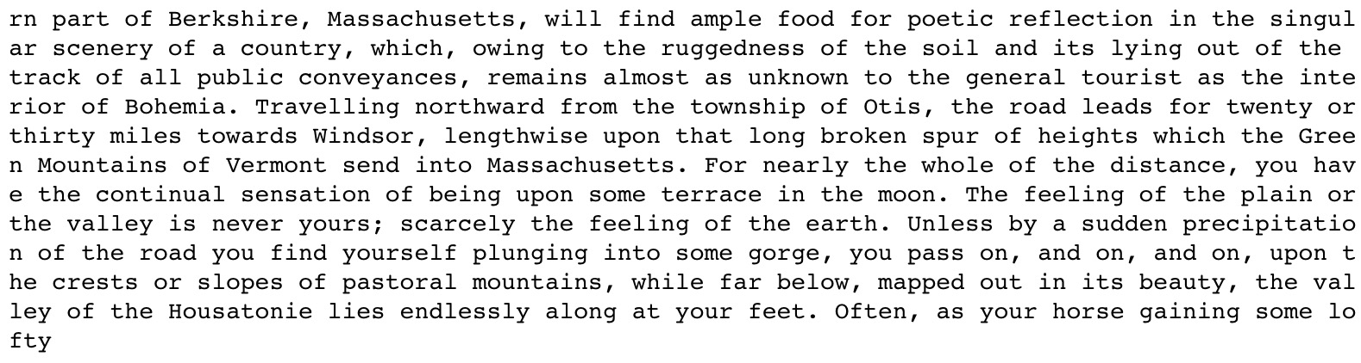
Sample Text: First 200 Characters of Israel Potter by Herman Melville

Slide 8
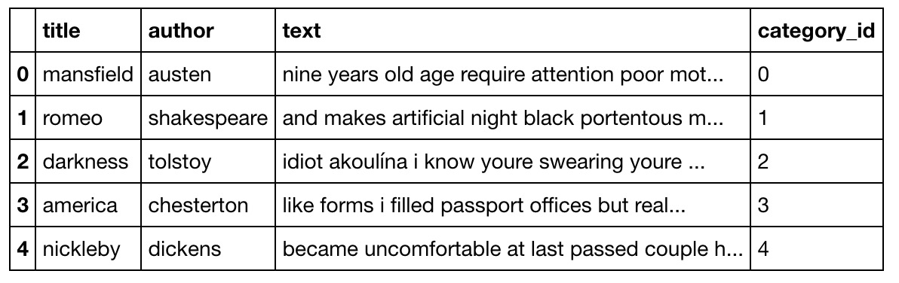
Data Frame of Preprocessed Data

Slide 9
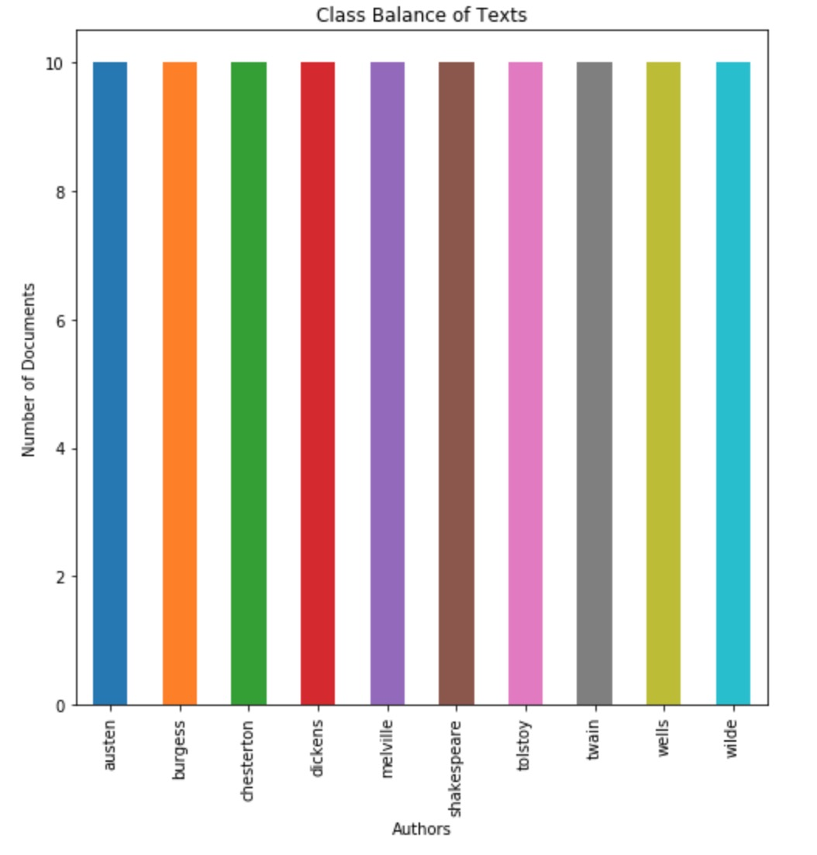
Class Balance

Slide 10
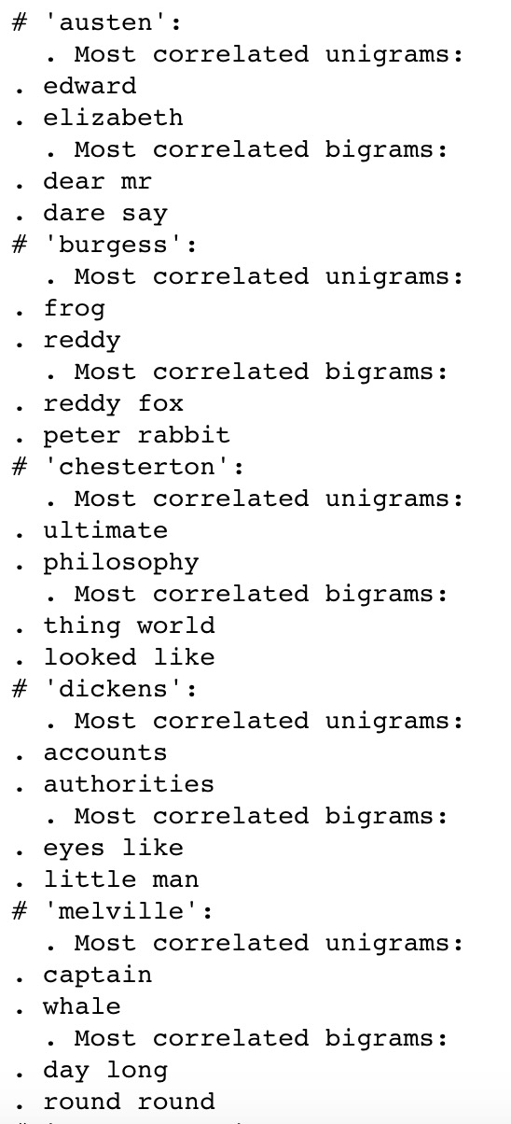
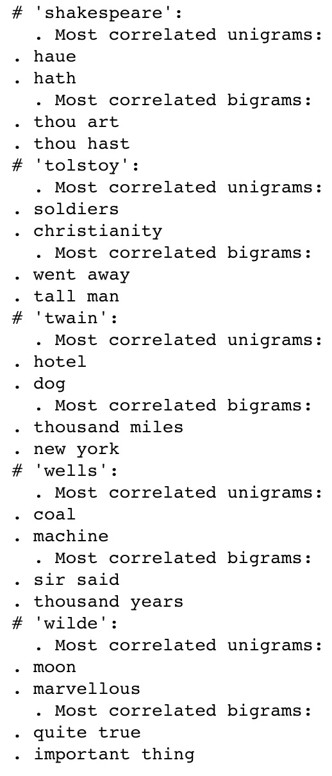
Feature Engineering: Unigrams And Bigrams

Slide 11
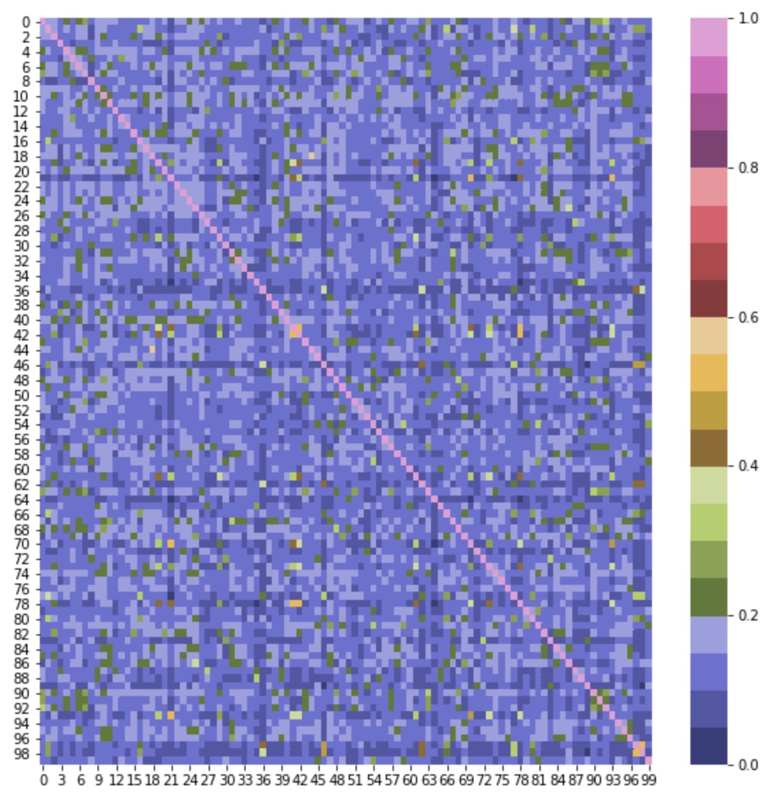
Heatmap Of Similarity Between Texts

Slide 12
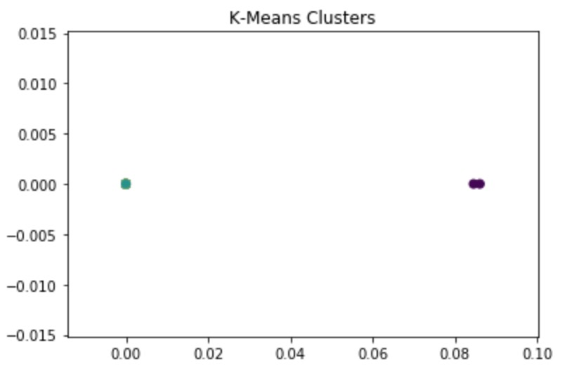
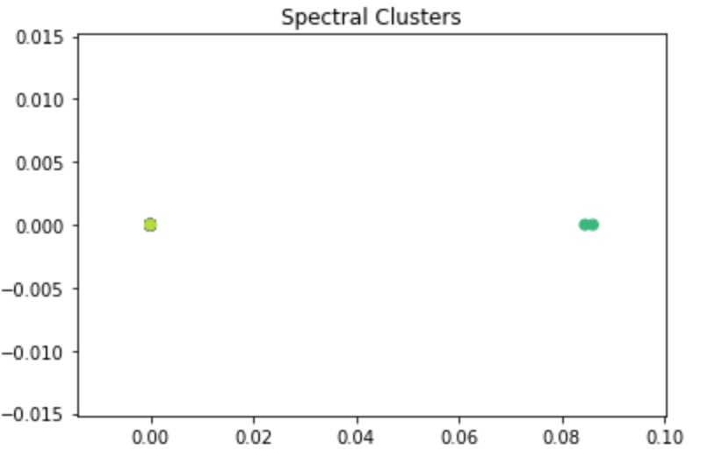


Clusters and their ARI

Slide 13
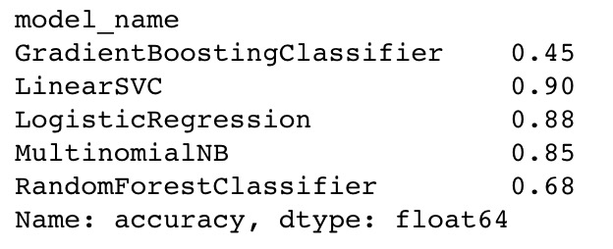
Cross Validation Data Frame And Mean Accuracy

Slide 14
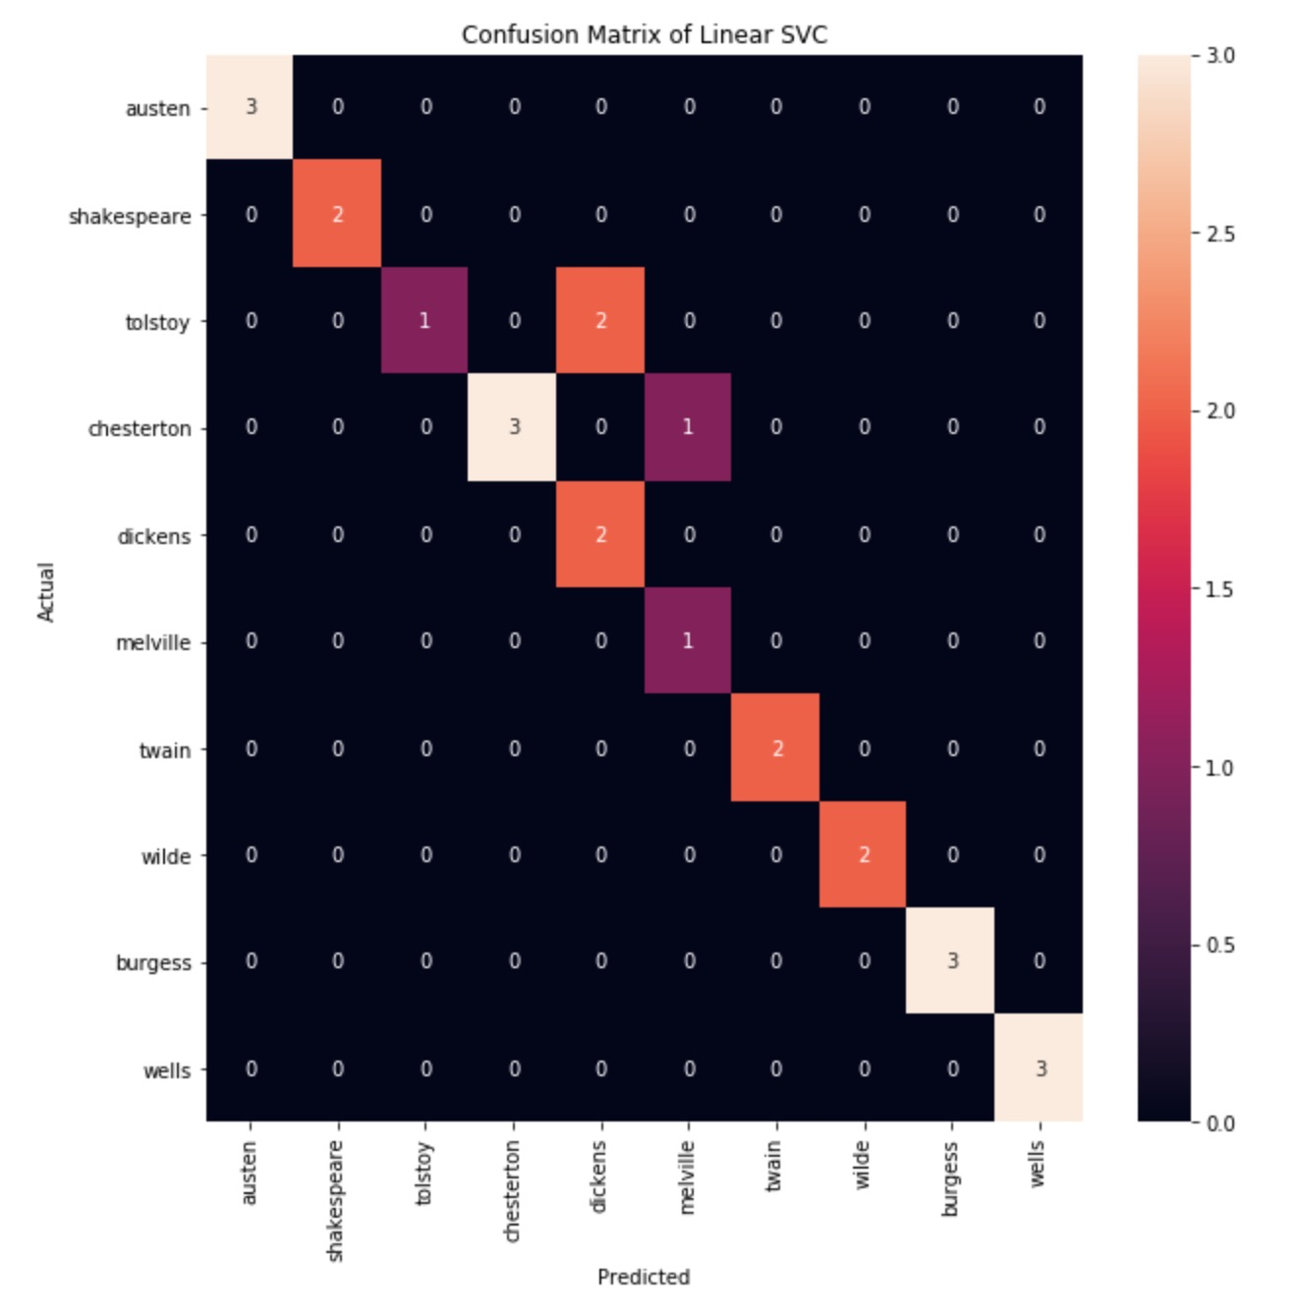
Linear SVC Confusion Matrix Heatmap

Slide 15
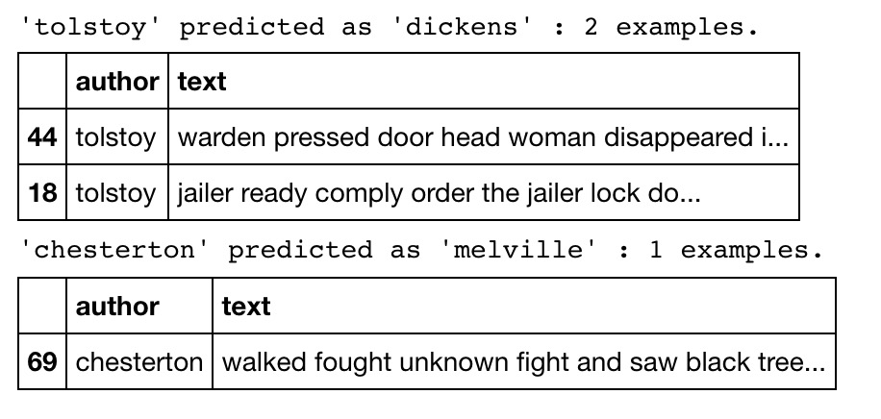
Mis-Predictions

Slide 16
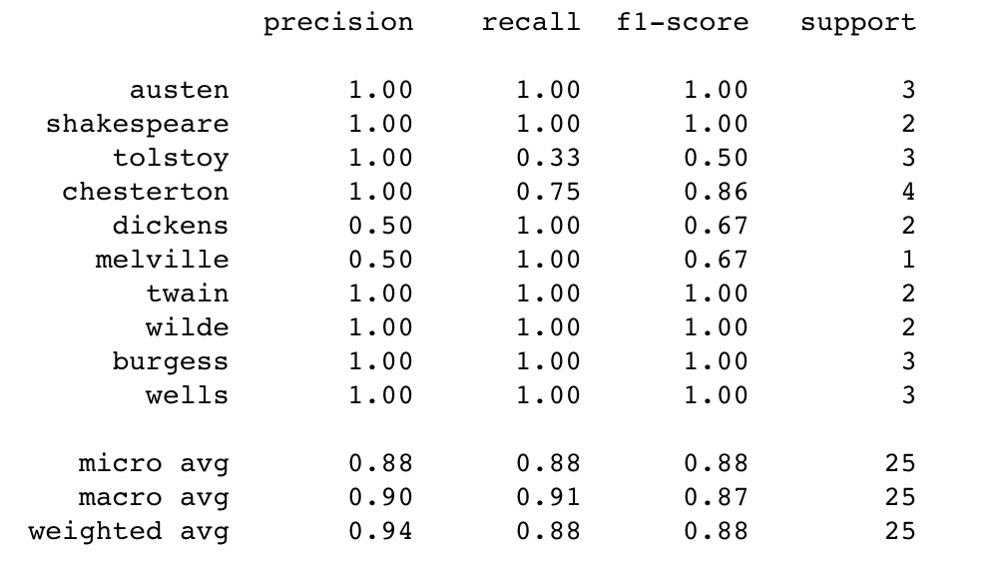
Table Of Model Evaluation Scores

Slide 17
Conclusions
Clustering algorithms performed far worse than any of the supervised learning models in classifying our texts to correct authors. The Adjusted Rand Index for both Spectral Clustering and the K-means algorithm were both below 0.5, indicating more randomness in their prediction than agreement between predicted and actual.
Our Linear Support Vector Classifier performed extremely well on our test group. It classifies our texts with 88% accuracy. Our cross-validation average score is 90%. Our precision is 94% and both recall and f1-scores on average at 88% as well. So this model is also consistent in its predictions, and reliable for use in identifying new texts written by the same authors.

Slide 18
Limitations And Improvements
Clustering Algorithm may require a larger and more diverse dataset. At only 10 texts per author with 100 authors, it's likely not enough information for the clusters to define their boundaries.
One limitation of this model is it's tendency to over-fit.
Another limitation is the size and diversity of our dataset. Although 100 documents is quite a large corpus for training modelling. We only have 10 documents per author. Furthermore, all of the texts are novels, so there isn't much diversity in the texts. We should use different types of inputs by the same authors so that the model can make predictions on different types of texts, such as short-stories, memoirs. If we implemented the model on modern authors, we can train the model on social media posts and blogs as well.
The 6,000 to the 18,000 character was used as a representative sample, instead of the whole text. If we had more computing power, we should train our model on the text.

Slide 19
Link To Data
http://www.gutenberg.org/wiki/Main_Page

